Slide 1
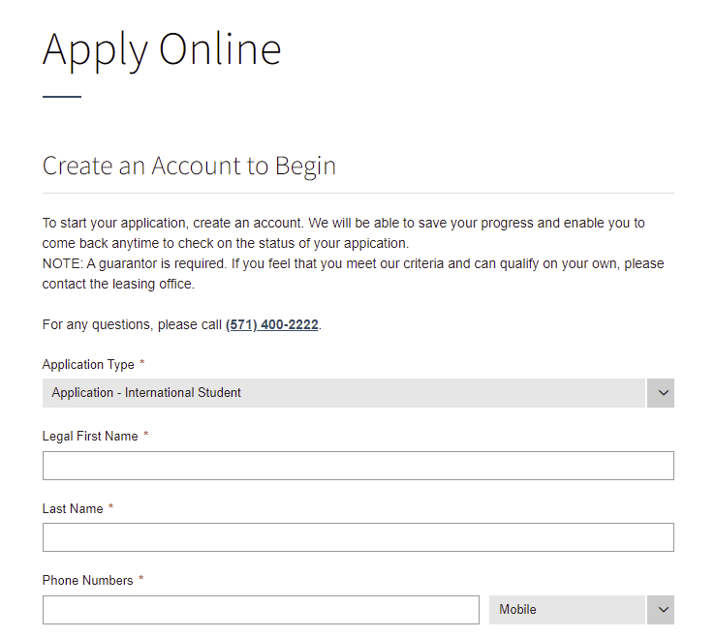
Lease Process Guidelines – International Students
How to Apply:
Go to www.theflatsonuniversity.com
  Click on “Apply Online” in the top right corner
Fill out the information to begin the application. PLEASE NOTE: You must select “Application - International Student” under application type
Please use The Flats on University’s phone number as the phone number for your application. That number is 571-400-2222
Once you have completed all items on this page click “create account” to begin.

Slide 2
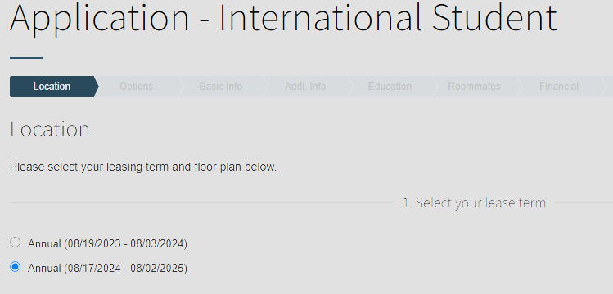
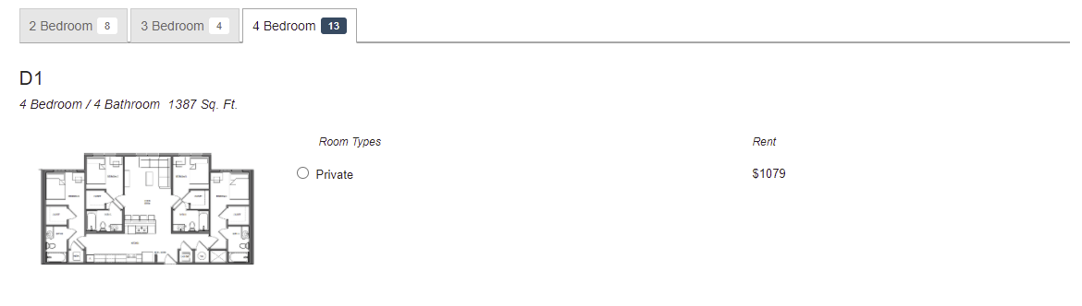
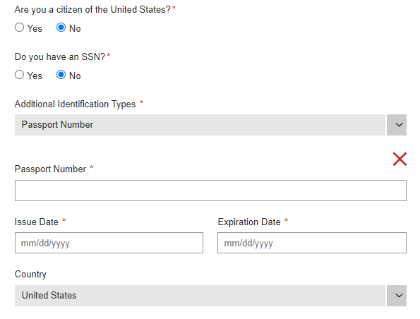
Select the Annual lease term and click “Save & Continue”
Next, select the floorplan you would like. Please note that some “Room Types” are “Private” while others are “Shared.”
Click Save & Continue at the bottom of the page and select any applicable “Options” on the next tab.
Under the “Basic Info” section you will select that you are NOT a US Citizen, and that you do NOT have a Social Security Number. In the dropdown box for “Additional Identification types please select “Passport Number” and enter the required information.

Slide 3
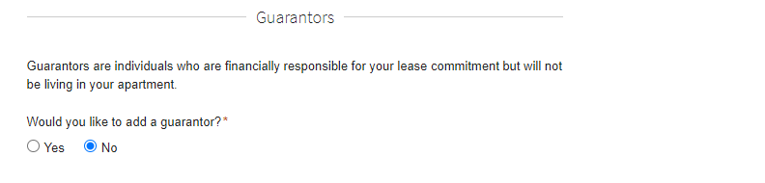
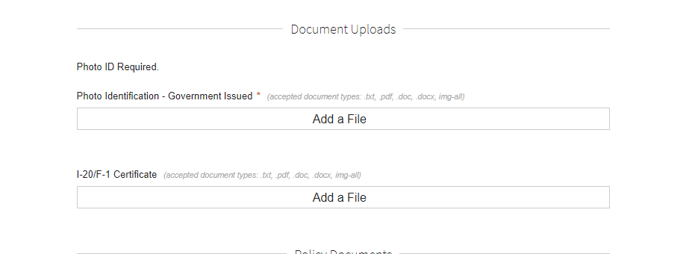
On the “People” section, please do not add a Guarantor. Guarantor is not required for international students; you will provide a copy of your I-20 prior to move-in.
“Summary” Tab - You will be required to upload a photo identification, this will need to be a photo of your passport.
If you have a copy of your I-20/F-1 Certificate you can upload it at this time, though it is not required during the application. You can submit this document at a later time.
“Payment” Tab – Pay signing fees as outlined on the screen
Click “Finish” at the bottom and your application will be complete. Once complete, you will be directed to your resident portal where you will see the link taking you to the lease agreement.

Slide 4
ADDITONAL QUESTIONS:
What phone number should I use?
  Use the The Flats on University’s phone number 571-400-2222 (if you do not have a U.S. phone number yet).
What is included in the rent?
  Rent includes use of the apartment and amenities at the building, furniture, and internet.
Are dishes, TVs, or housewares included?
  NO, you will need to communicate with your roommates (once you receive your placement email in the summer) about who will be bringing common area housewares for the apartment.
Who will I be roommate matched with?
  We make placements based off of the roommate matching profile questions during the application process. We will make every effort to accommodate any preferences you have for your roommates. If you have specific roommates in mind, please indicate who those roommates are so we can match you with them.
How close are you to the university campus?
  We are approximately one mile away from campus. The Cue bus will service our community to the campus!
How do I know that I will be living with the friend(s) I’m signing with?
  During the application process you will list your roommates’ names, emails, and phone numbers. This will allow us to place you together.
When is August rent due?
  Rent is due on the 1st and late after the 3rd of each month.
Why do we pay a full month’s rent for August?
  Your lease agreement is an installment contract. The installment amount is determined by taking the total value of the apartment from August 17th through the end of your lease agreement and dividing that into equal installments due on the 1st of each month.
What if I only need the apartment until the end of the spring semester? Can I get out of the rest of my lease?
  Your lease is valid from August 17, 2024 – August 2, 2025. The only way to be free from the financial responsibility to your lease agreement is to find someone to take over your lease (sometimes called a re-lease or a lease reassignment.) Once a potential tenant is found, they will need to be connected with our office to determine if they qualify to subsequently execute a lease agreement. Only then can you be released from your financial obligation to the contract.
Feel free to DM or call us on Instagram (@flatsonuniversity) if you have other questions or need additional assistance!

